Slide 1

L1.2 AV Sensors, HD Maps
Zonghua Gu 2023

Slide 2
AV SENSORS

Slide 3
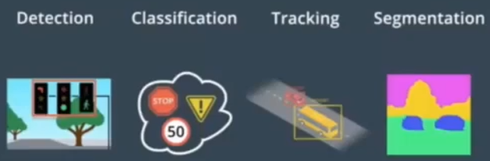
Perception Tasks
4 main perception tasks
Detection
Detect the existence of an object in the environment
Classification
Identify what the object is, e.g., traffic sign, traffic light, pedestrian
Tracking
Track a moving object across time
Segmentation
Semantic segmentation: classify each pixel to its semantic category, e.g., road, car, sky…
Instance segmentation: classify each pixel to an object instance, e.g., car1, car2…
Mobileye's Autonomous Car What the System Sees
https://www.youtube.com/watch?v=jKfwHsHUdVc

Slide 4
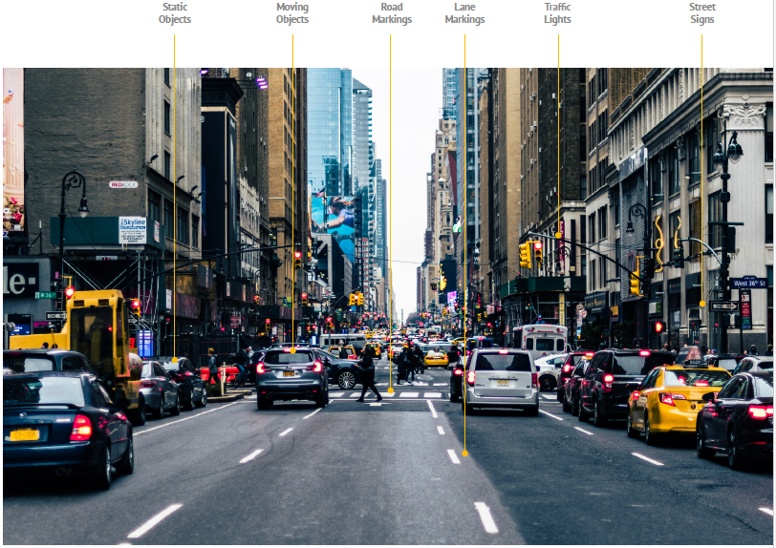
The variety of static and moving objects that an AV needs to detect and recognize

Slide 5
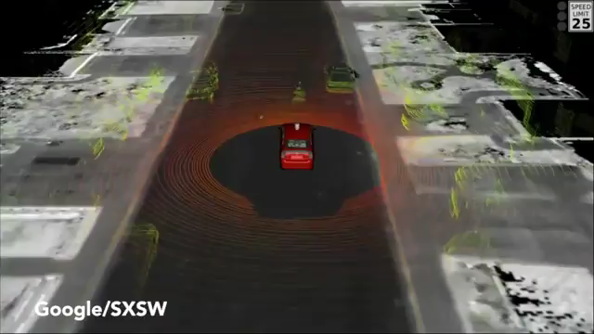
Perception is Challenging
The long tail distribution is challenging: anything can happen on the road!
Video from 2015, recorded by Google’s AV.

Slide 6
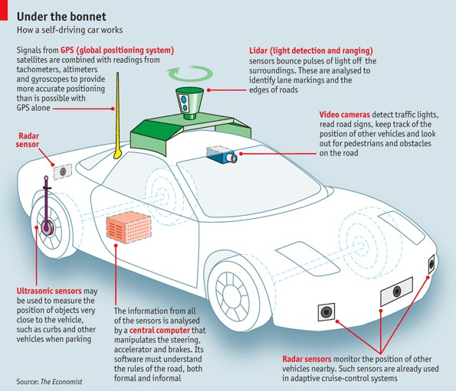
The Typical AV Sensor Configuration
Notes:
Global Positioning System (GPS) • Light Detection and Ranging (LIDAR) • Cameras (Video) • Ultrasonic Sensors • Central Computer • Radar Sensors • Dedicated Short-Range Communications-Based Receiver (not pictured)
https://www.economist.com/the-economist-explains/2015/05/12/how-does-a-self-driving-car-work
Cameras – Provide real-time obstacle detection to facilitate lane departure and track roadway information (like road signs).
Radar – Radio waves detect short & long-range depth.
LIDAR – Measures distance by illuminating target with pulsed laser light and measuring reflected pulses with sensors to create 3-D map of area.
GPS – Triangulates position of car using satellites. Current GPS technology is limited to a certain distance. Advanced GPS is in development.
Ultrasonic Sensors – Uses high-frequency sound waves and bounce-back to calculate
distance. Best in close range.
Central Computer – “Brain” of the vehicle. Receives information from various components and helps direct vehicle overall.
DRSC - Based Receiver – Communications device permitting vehicle to communicate with other vehicles (V2V) using DSRC, a wireless communication standard that enables reliable data transmission in active safety applications. NHTSA has promoted the use of DSRC.

Slide 7
Configuration of Sensors of Some Research AVs
 | Uber | Waymo | GM Cruise | Navya Autonomy Cab | Drive.ai | Nissan | Tesla Autopilot V9
Cameras | 8 | 8 | 16 | 6 | 10 | 12 | 8
Lidars | 1 | 6 | 5 | 10 | 4 | 6 | 0
Radars | 4 | 4 | 8 | 4 | 2 | 9 | 1
Tesla is one of the few AD companies that do not use Lidar.
Elon Musk, 2017:
“Once you solve cameras for vision, autonomy is solved; if you don’t solve vision, it’s not solved … You can absolutely be superhuman with just cameras.”
“In my view, Lidar is a crutch that will drive companies to a local maximum that they will find very hard to get out of. Perhaps I am wrong, and I will look like a fool. But I am quite certain that I am not.”
Notes:
My opinion: Cameras should be enough, theoretically, since humans drive quite well with their eyes as the only sensor. But in practice, computer vision algorithms are not yet at the level of human visual system (eyes+brain), and Lidar can be very helpful. (I think one reason of not using lidar is to save cost.)

Slide 8
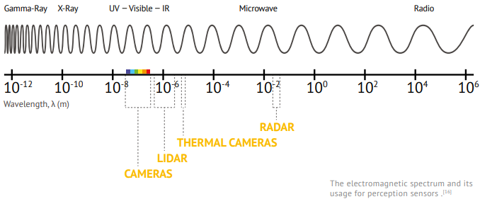
Passive vs. Active Sensors
Passive sensors detect existing energy, like light or radiation, reflecting from objects in the environment.
Cameras
Active sensors (also called range sensors) send their own signal and sense its reflection
Lidar, Radar, ultrasound
https://www.wevolver.com/article/2020.autonomous.vehicle.technology.report

Slide 9
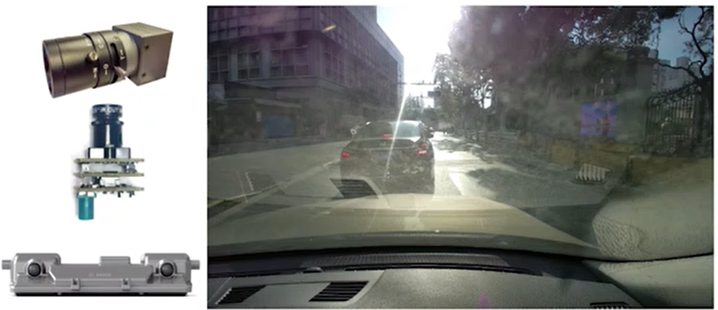
Camera
Pro: cheap, versatile, stereo vision w. two cameras
Con: easily affected by illumination conditions, needs additional light at night
Key parameters
Resolution
e.g.,1080p HD cameras provide 1920x1080-pixel resolution, or 2.1 megapixels.
Field of View (FOV)
The extent of the observable world that is seen at any given moment
Given same resolution, wider FOV results in large image distortion.
Dynamic range
Maximum difference between the darkest and lightest pixel intensities in an image, measured in dB. An AV needs HDR (High-Dynamic-Range) cameras with at least 100dB.
Notes:
The human eye can perceive about 20 stops of dynamic range, i.e, we can perceive $2^{20}=1$ million times darker than the brightest ones in the same scene
The most versatile sensor (main sensing modality of humans).

Slide 10
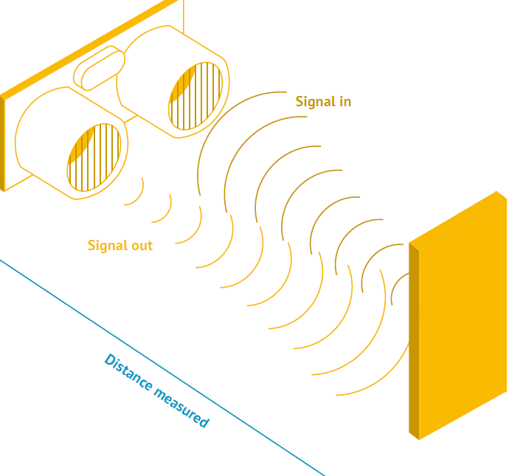
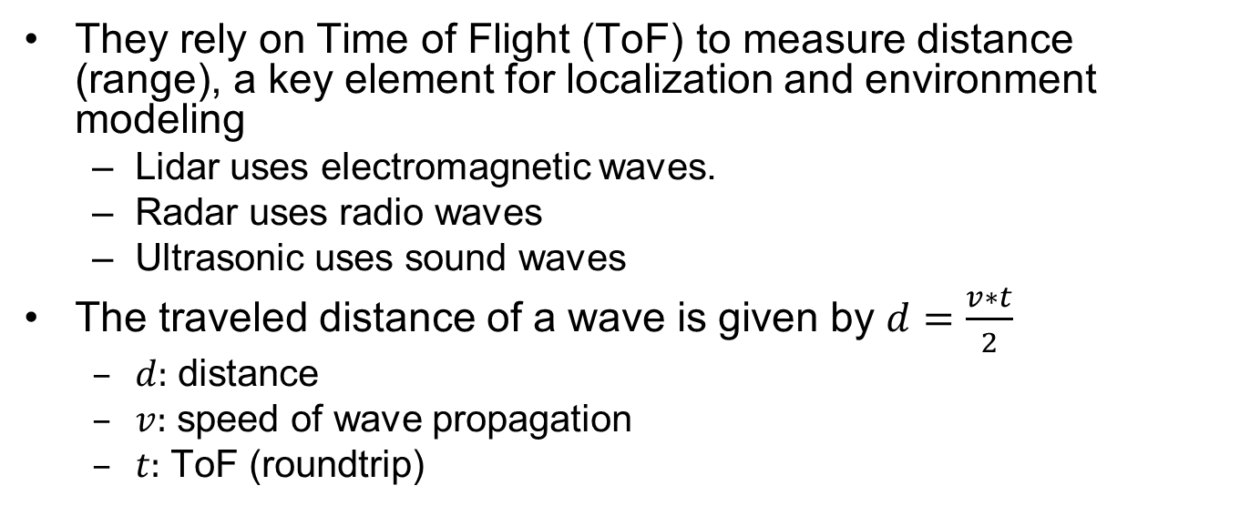
Range Sensors
They rely on Time of Flight (ToF) to measure distance (range), a key element for localization and environment modeling
Lidar uses electromagnetic waves.
Radar uses radio waves
Ultrasonic uses sound waves
The traveled distance of a wave is given by $d=\frac{v∗t}{2}$
$d:$ distance
$v:$ speed of wave propagation
$t:$ ToF (roundtrip)

Slide 11
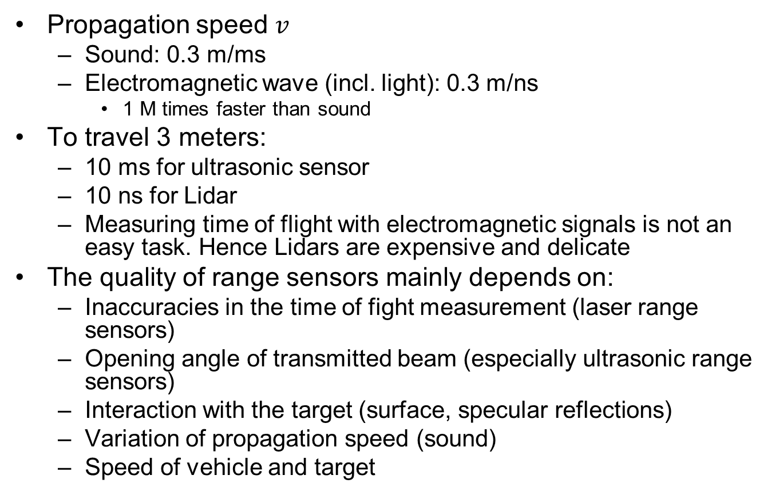
Range Sensors
Propagation speed $v$
Sound: 0.3 m/ms
Electromagnetic wave (incl. light): 0.3 m/ns
1 M times faster than sound
To travel 3 meters:
10 ms for ultrasonic sensor
10 ns for Lidar
Measuring time of flight with electromagnetic signals is not an easy task. Hence Lidars are expensive and delicate
The quality of range sensors mainly depends on:
Inaccuracies in the time of fight measurement (laser range sensors)
Opening angle of transmitted beam (especially ultrasonic range sensors)
Interaction with the target (surface, specular reflections)
Variation of propagation speed (sound)
Speed of vehicle and target

Slide 12
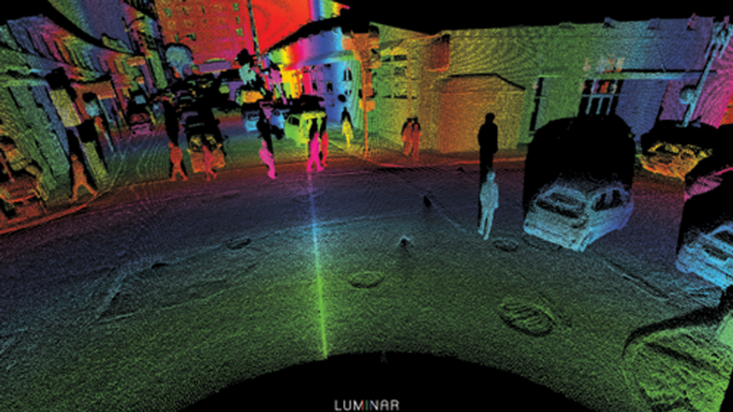
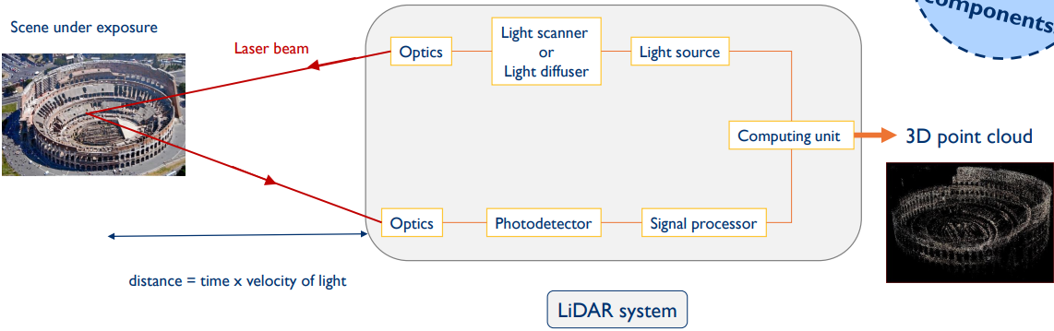
Lidar
Lidar (Light Detection and Ranging Device) sends millions of light pulses per second in a well-designed pattern to generate “Point Clouds” that describe the 3D geometry of the surrounding environment
Pro: independent of lighting conditions, precise distance measurements for 3D perception
Con: expensive, medium resolution
Key parameters:
Laser beam count
Rotation Speed
FOV
Range distance (from tens to hundreds of meters)
Notes:
Figure shows the ideal detection results from a 3D LIDAR, with all the moving objects being identified. . With its rotating axis, it is able to create a dynamic, 3D map of the environment. Point clouds per Second

Slide 13
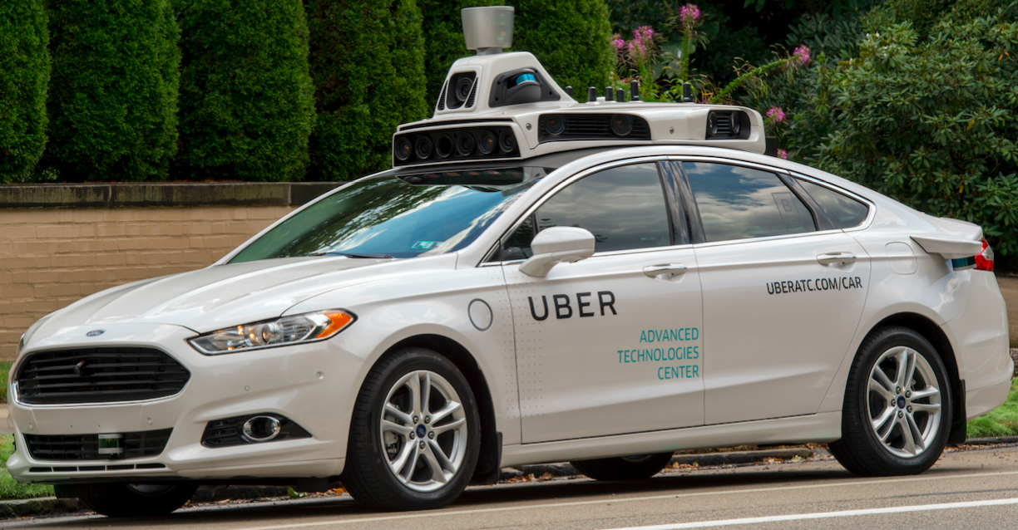
Velodyne Lidar
The high-end Velodyne HDL-64E with 64 laser emitters
Rotation rate up to 15 Hz
FOV is 360° horizontally and 26.8° vertically
Angular resolution is 0.09° and 0.4° respectively
Delivers ~1.3M data points per second
Expensive (~USD$40-80K) (cheaper versions available)
Notes:
than SICK laser range finders (SICK ~$2-4K, Velodyne Today hundreds of Lidar products are on the market, some with very low prices.
The distance accuracy is better than 2 cm and can measure depth up to 50 m
Its position on top of the car increases air resistance and reduces mileage (maybe a minor concern).

Slide 14
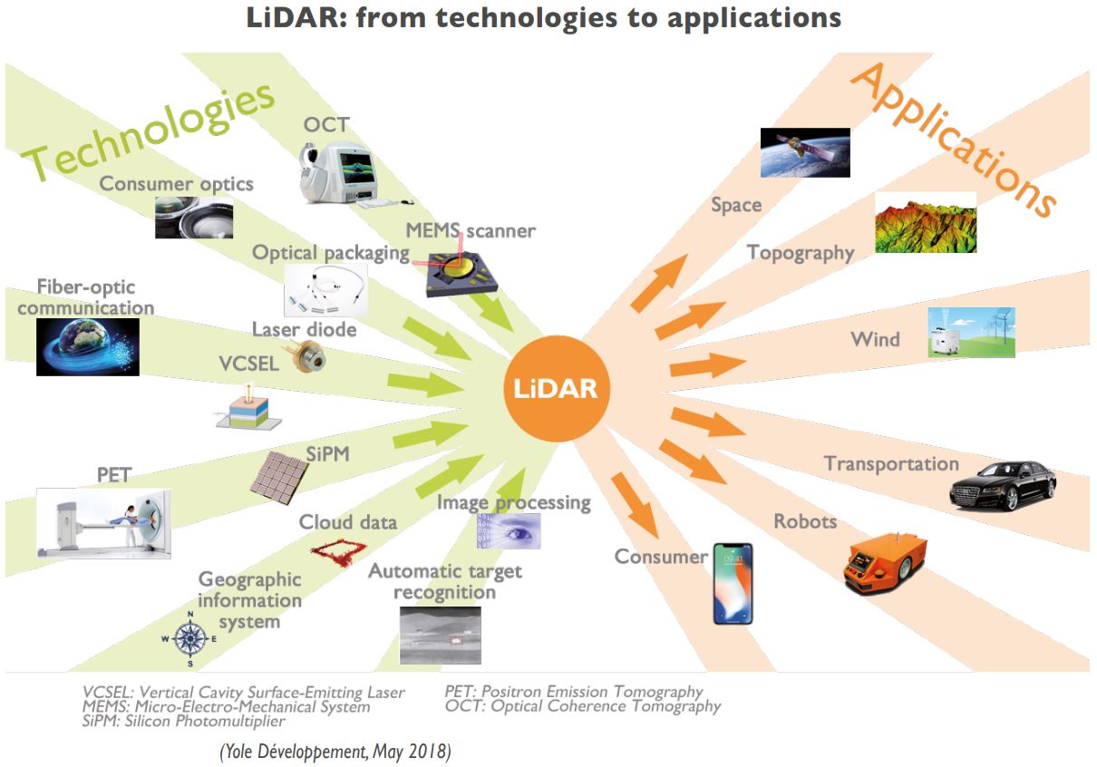
Many Variants of Lidars in the Market
http://www.f4news.com/2018/05/04/yole-on-lidar-market/

Slide 15
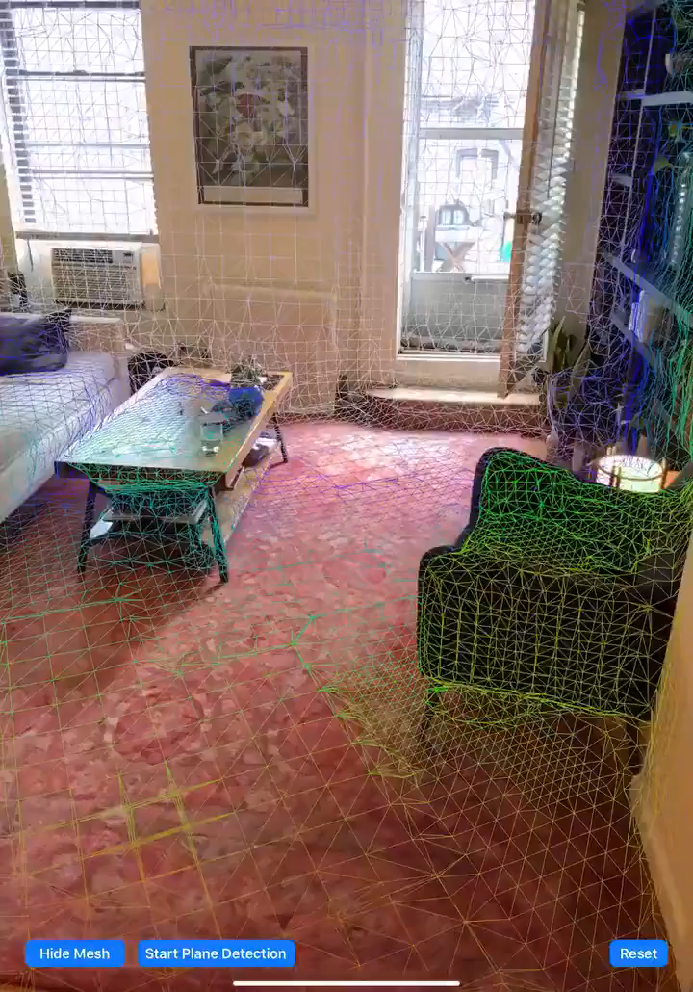
Apple iPAD Pro has Built-in Lidar (2020)
It allows users to scan a depth-accurate depiction of the environment.
Main application: Augmented Reality (AR)
Needs depth information to place virtual objects in the environment.
Notes:
it allows users to scan a depth-accurate depiction of their surroundings

Slide 16
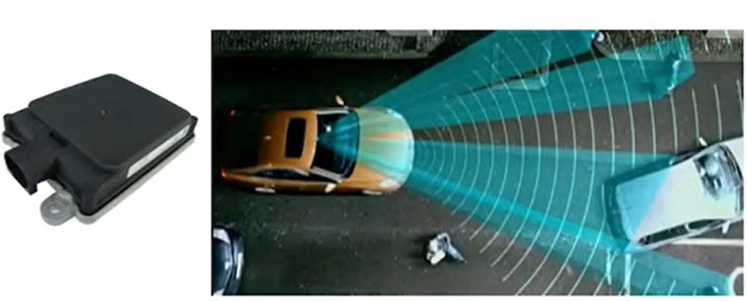
mmWave Radar
Pro: provides both position and relative speed information; can operate in varied conditions (low-lighting, rain, fog…)
Con: low resolution
Key parameters
Sensing distance, FOV, Position and velocity accuracy
Two types
Short-medium range with wide FOV
Long range with narrow FOV
Notes:
For accurate target detection and relative speed measurement (main sensing modality of bats)
https://semcon.com/offerings/applied-autonomy/lidar-vs-radar-for-applied-autonomy/
Long operating distance
It can operate in more varied conditions and environments. Since it is not as sensitive to for example dirt and it does not have any mechanical moving parts.

Slide 17
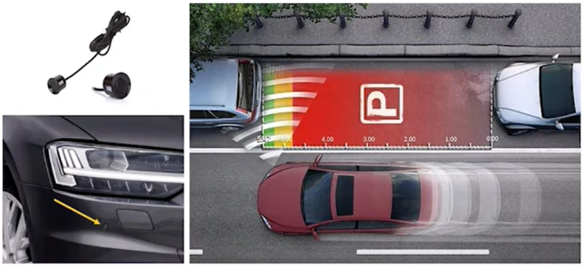
Ultrasound
Pro: not affected by lighting conditions, rain or fog
Con: short sensing range (mainly used for parking assistance)
Key parameters
Sensing range
FOV

Slide 18
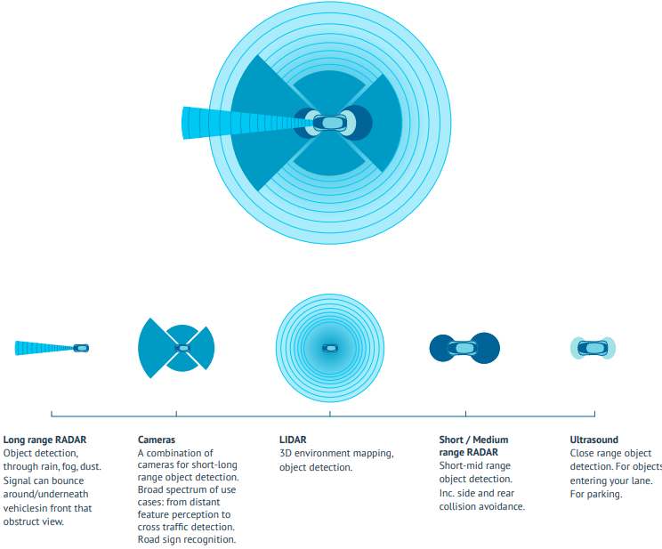
Comparison of Sensing Ranges
https://www.wevolver.com/article/2020.autonomous.vehicle.technology.report

Slide 19
Other Comparisons
Each sensor has its strengths and weaknesses
Sensor fusion crucial for robust perception
 | Camera | Lidar | Radar
Sensing Range | Mixed | Mixed | Good
Functioning in bad weather | Poor | Mixed | Good
Functioning in poor lighting | Mixed | Good | Good
Object Detection | Mixed | Good | Mixed
Object Classification | Good | Mixed | Poor
Lane Tracking | Good | Poor | Poor

Slide 20
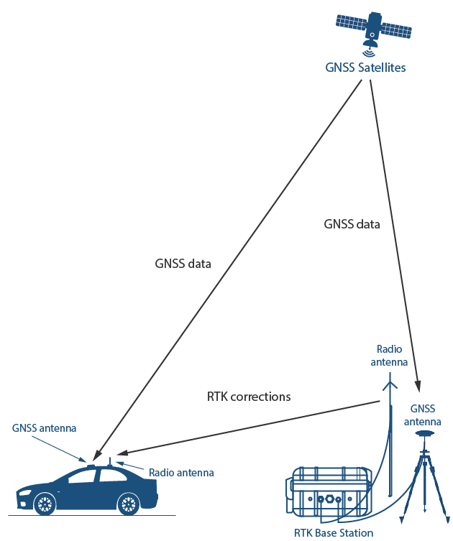
GNSS/GPS
GNSS (Global Navigation Satellite System) provides localization service for outdoor applications. Current GNSS systems include:
GPS (USA), Galileo (Europe), Beidou (China), GLONASS (Russia)
Conventional GPS provides a few meters accuracy, affected by cloud covers and tall buildings; RTK (Real-Time Kinematic) GPS can provide centimeter-level accuracy by calculating and transmitting differential correction data via radio to allow the roving GPS system (vehicle) to correct its position

Slide 21
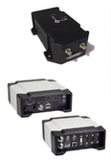
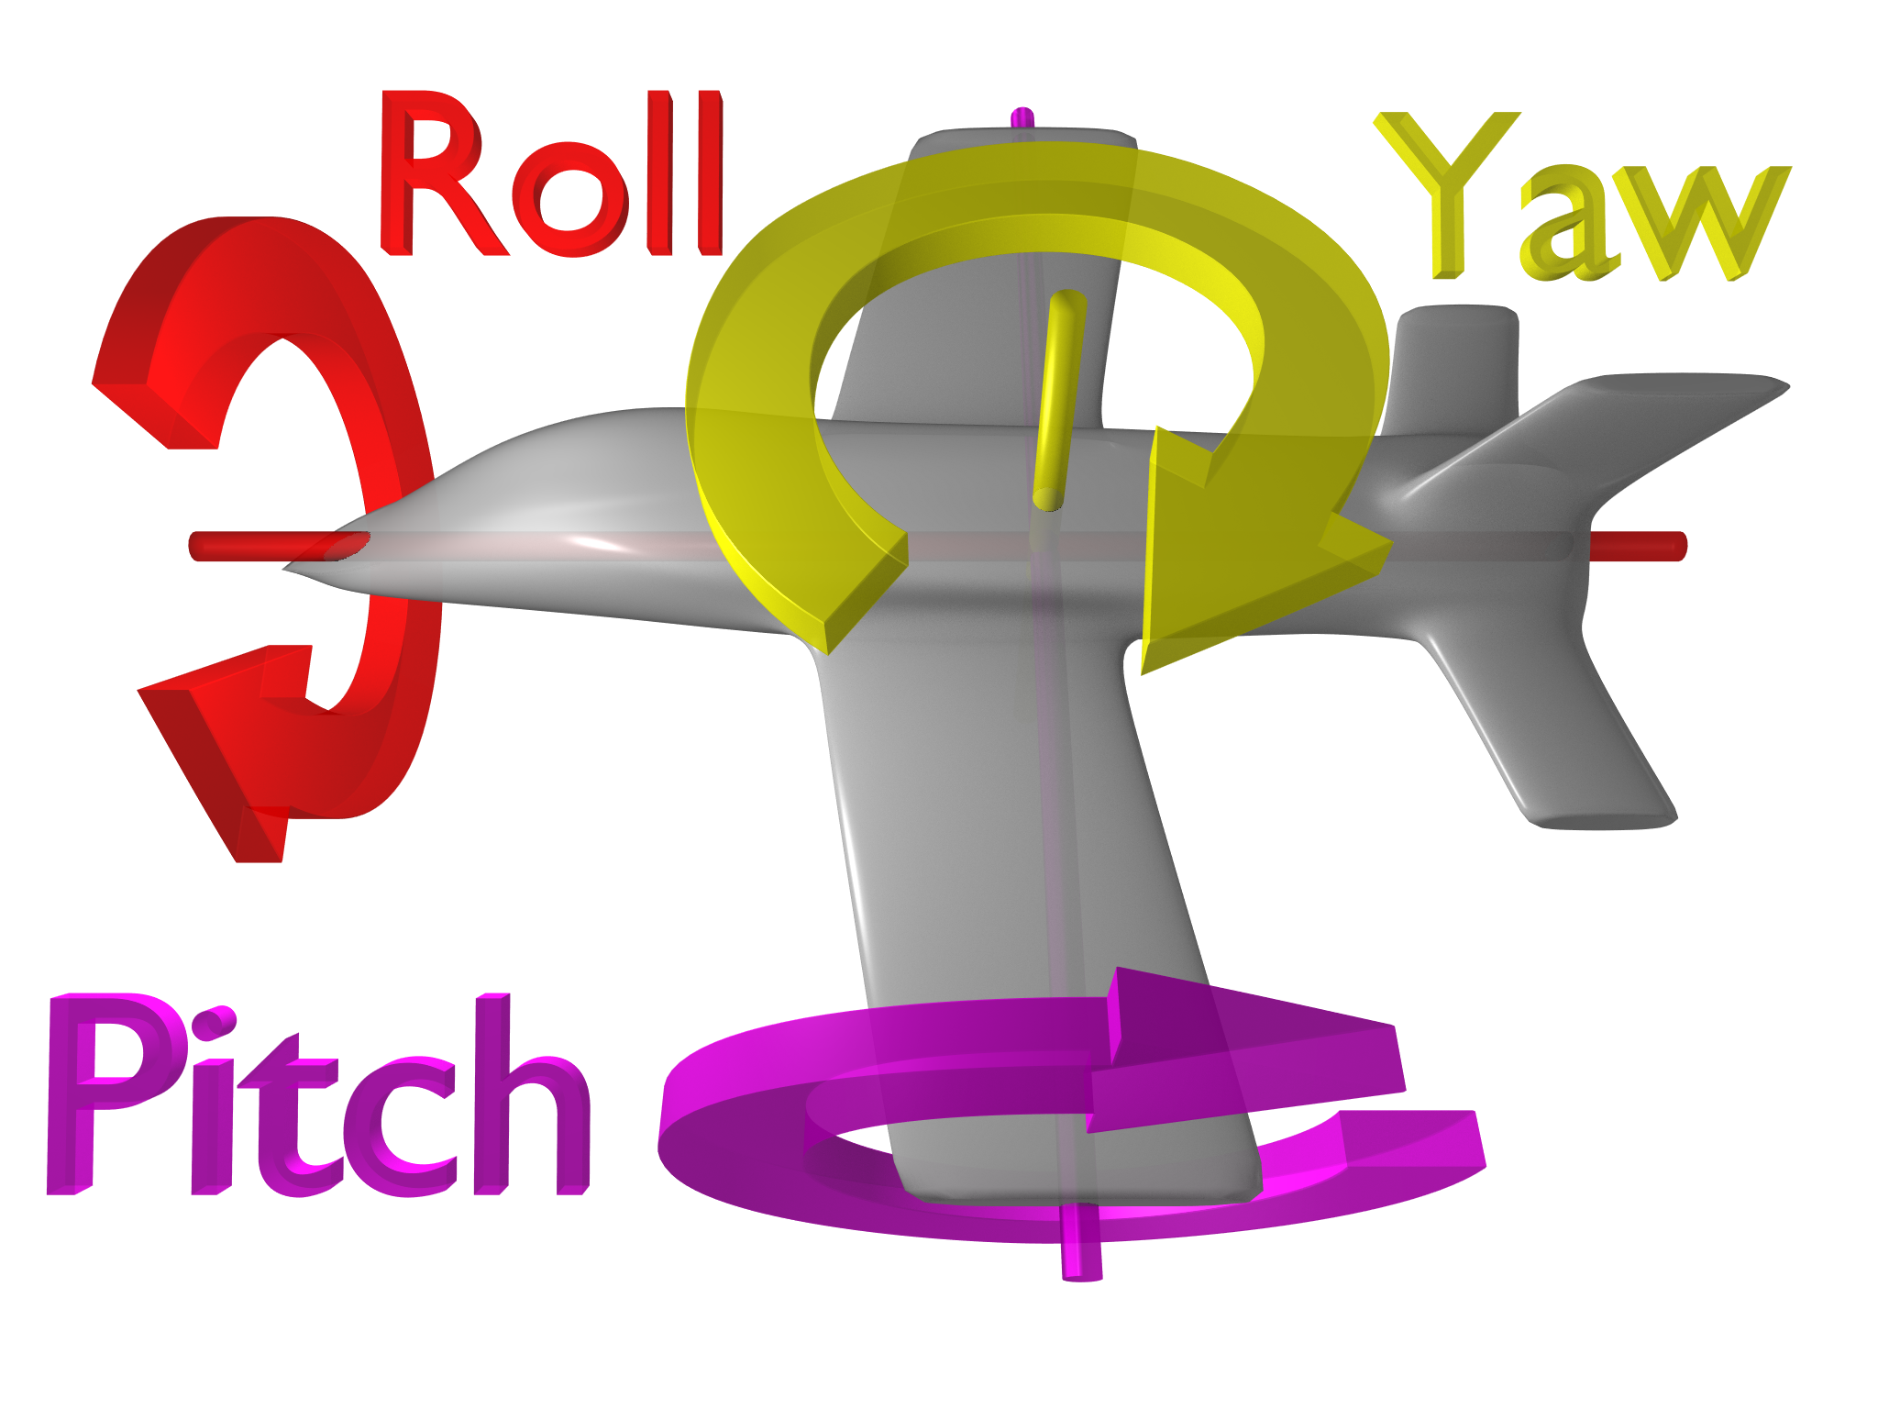
IMU
IMU (Inertial Measurement System) measures acceleration (linear and angular) and orientation (yaw, pitch, roll)
For ground vehicles on 2D plane, only yaw is relevant.
For aerial vehicles in 3D space, all three are relevant
Often combined with GNSS/GPS to form INS (Integrated Navigation System), using sensor fusion to achieve higher estimation accuracy
Notes:
It uses gyroscopes and accelerometers to estimate the relative position (x, y, z), orientation (roll, pitch, yaw), velocity, and acceleration of a moving vehicle with respect to an inertial frame
After long periods of operation, drifts occurs; need external reference to cancel it
Kalman Filter, Particle Filter…

Slide 22
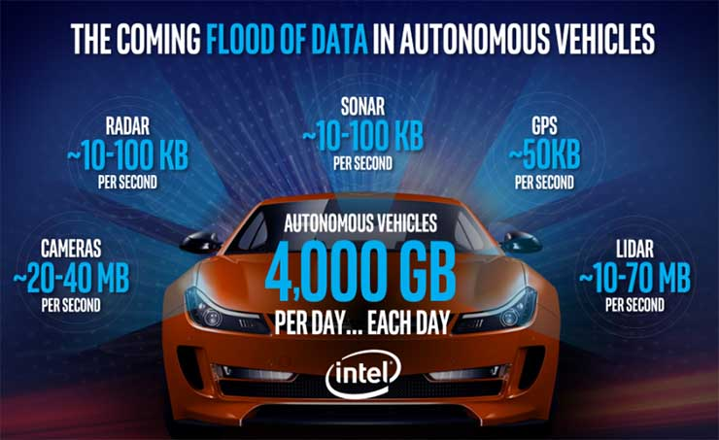
AV Sensors Generates Big Data
Sensors, esp. cameras and lidars, generate the most amount of data
Sensor data must be processed in real-time by perception algorithms
https://datacenterfrontier.com/autonomous-cars-could-drive-a-deluge-of-data-center-demand/
Notes:
Cameras: ~20-40 MB/s
Lidars: ~10-70 MB/s
Radars: ~10-100 KB/s
Sonars: ~10-100 KB/s
GPS: ~50 KB/s
An AV can generate ~4TB/day sensor data that must be processed in real-time

Slide 23
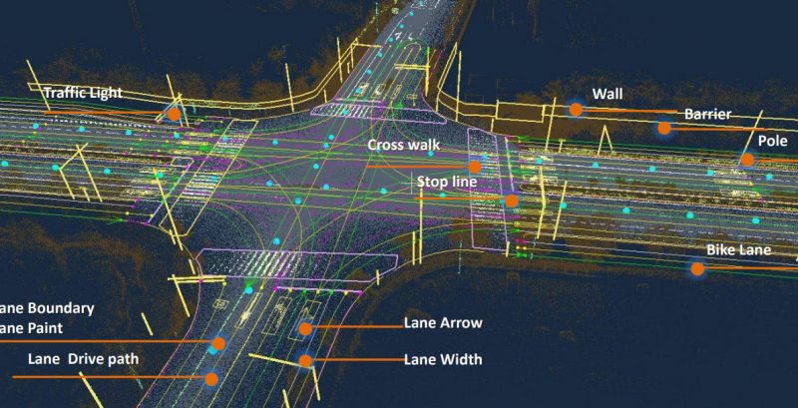
High-Definition (HD) Maps

Slide 24
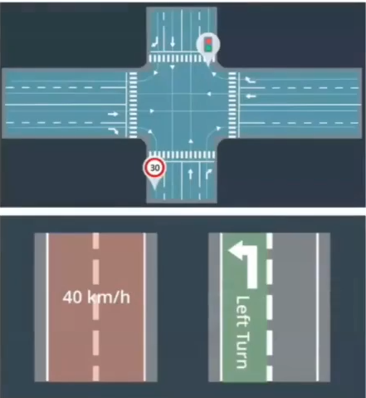
HD Maps
Different from navigation maps (e.g., Google Maps), HD maps are designed for processing by computers
Highly-accurate (cm-level) 3D representation of the road network, e.g., cross section layout; locations of traffic lights/signs; semantic information on certain road segments (speed limits…)

Slide 25
HD Maps Pros and Cons
Pros:
Helps with lane detection, and localization based on known object positions, esp. under adverse weather conditions such as snow, rain and fog
Reduces computational workload of on-board sensing, e.g., by reducing Region-of-Interest (ROI) for detection of traffic elements
The more that has already been mapped out, the easier it is for the on-board system to focus on the moving parts; mapless systems must figure out everything on-the-fly with no prior knowledge of the environment
Cons:
Limits the area of operation; mapless systems allow universal operation anywhere
Notes:
help with recognition of lane center line

Slide 26
Are HD Maps Necessary?
Humans don’t need HD maps to drive
It is generally agreed that L4-L5 levels of automation cannot work without HD maps (e.g., Waymo heavily relies on HD maps); L2-L3 levels may work without them (e.g., Tesla does not use HD maps)

